Slide 1

Elements Business Development Task
By : Mohamed Elgindy

Slide 2
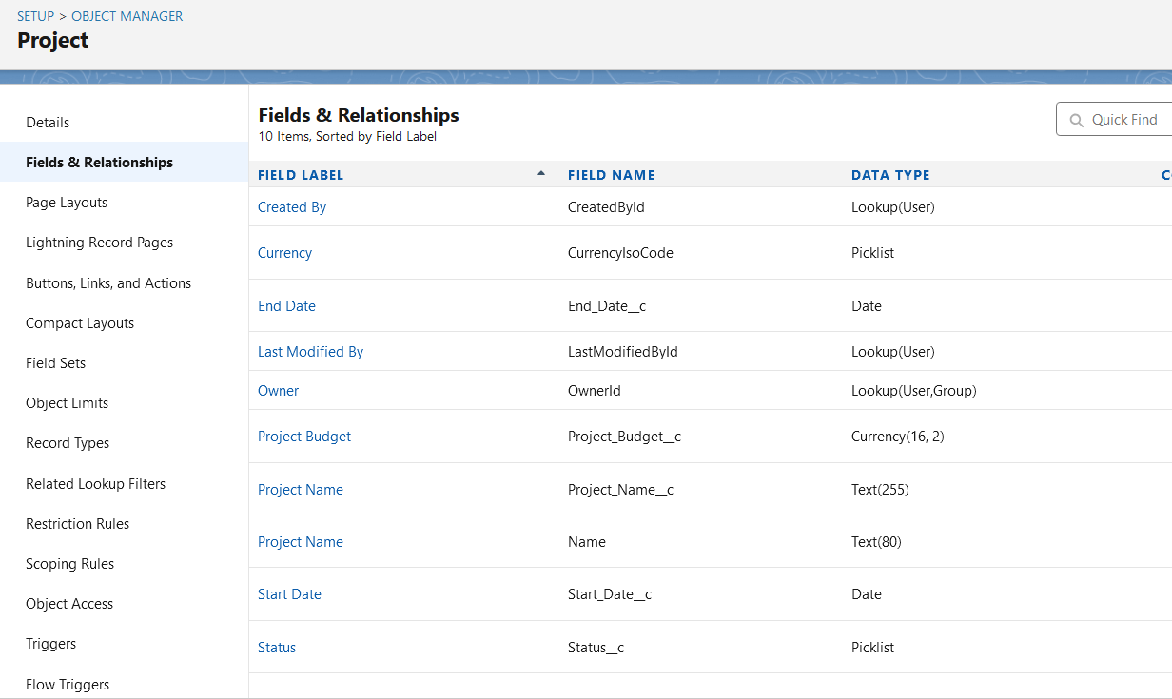
Project Opjects and component

Slide 3
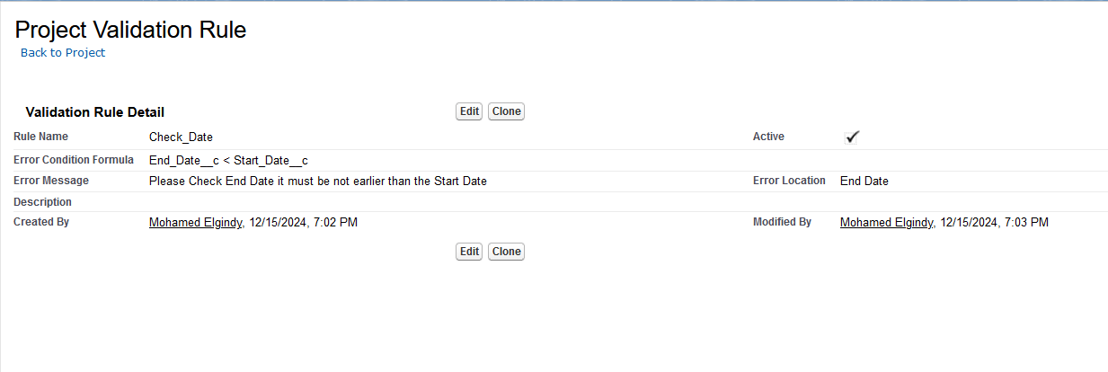
validation rule

Slide 4
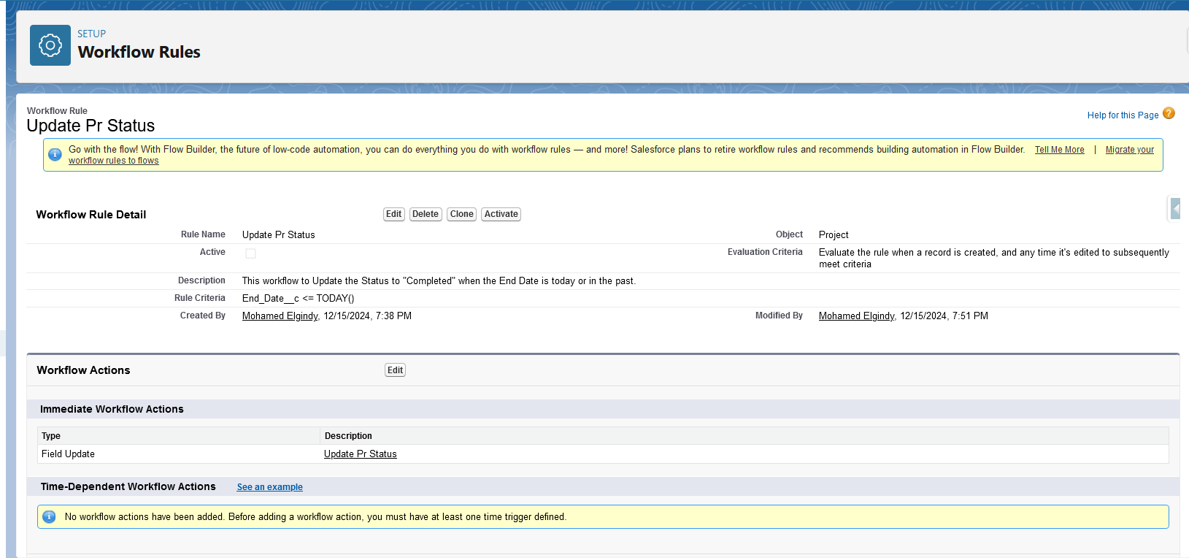
Workflow To Update Status

Slide 5
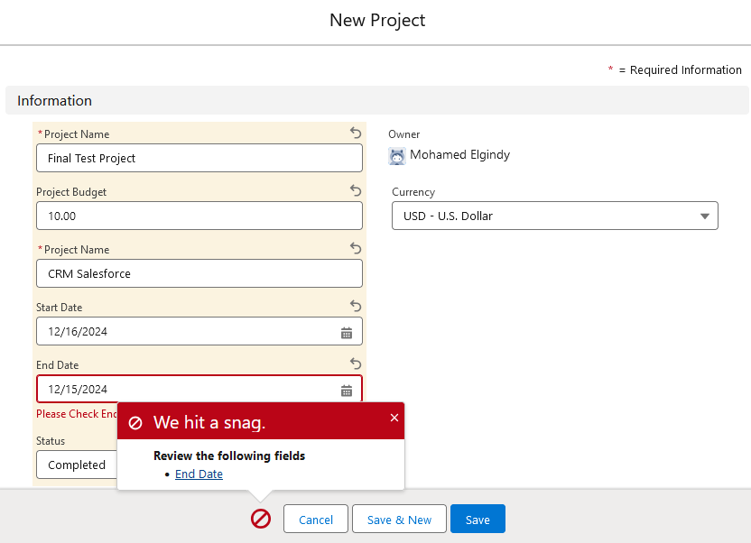
Date Validation

Slide 6
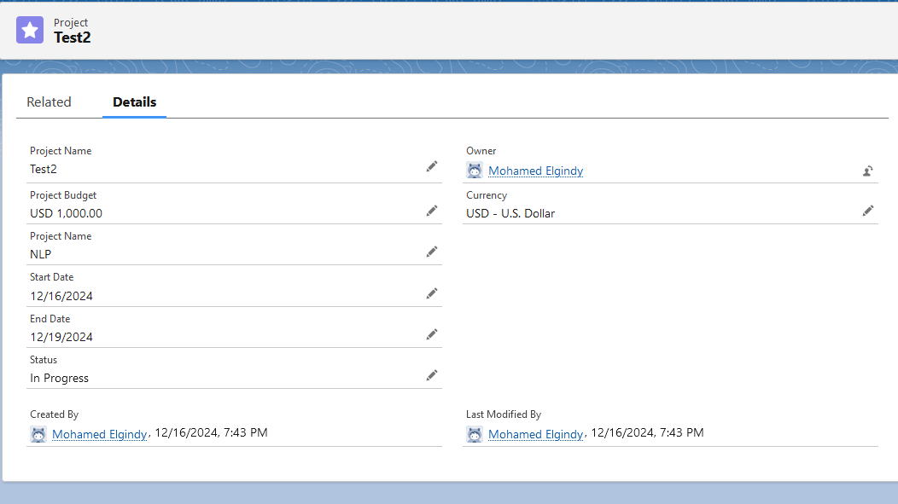
Test Demo

Slide 7
Apex Programming Task

Slide 8
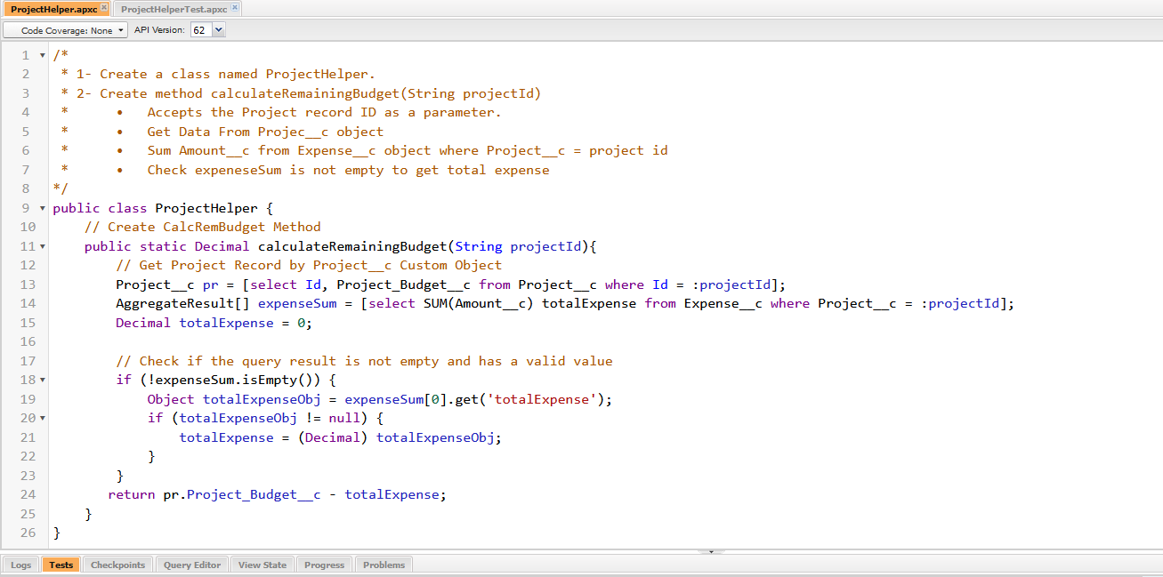
ProjectHelper Class

Slide 9
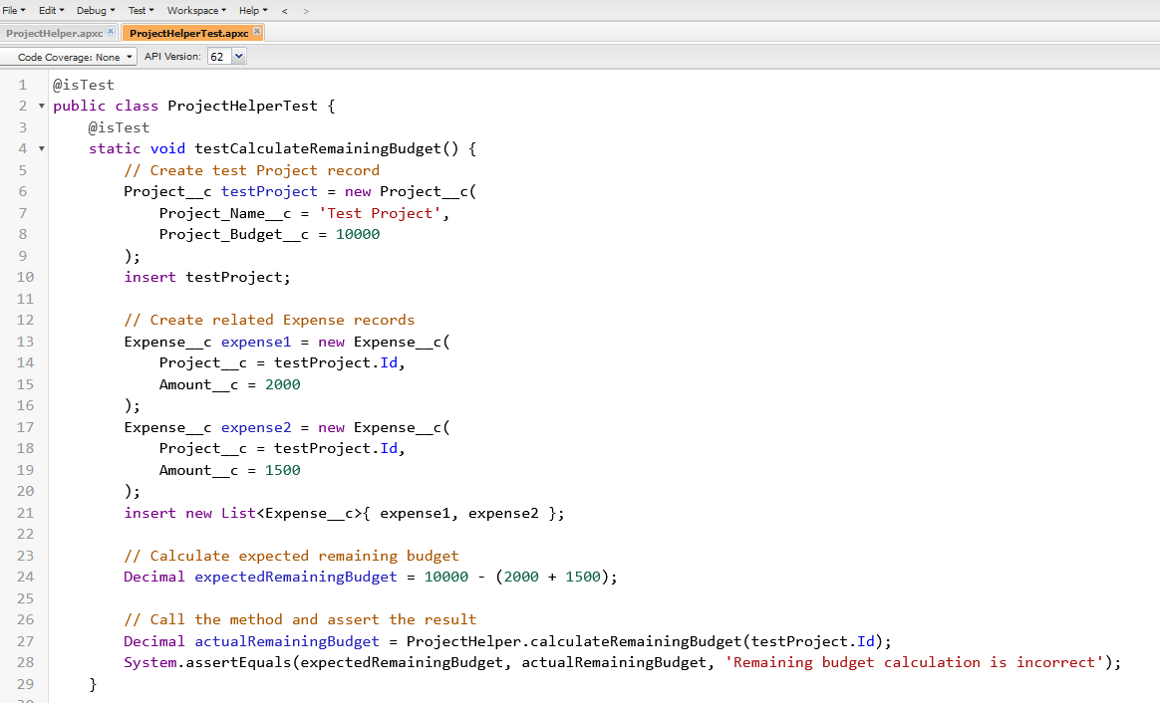
ProjectHelperTest class

Slide 10
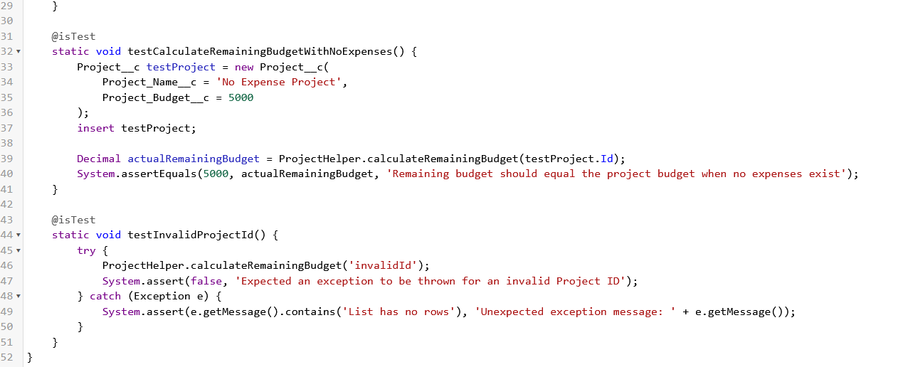
ProjectHelperTest class

Slide 11
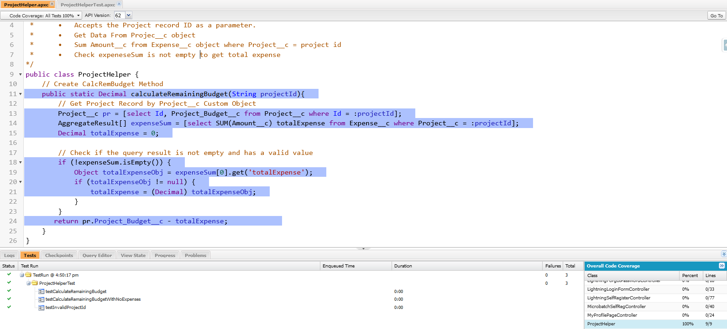
Test code coverage

Slide 12
Lightning Web Component (LWC) Task

Slide 13
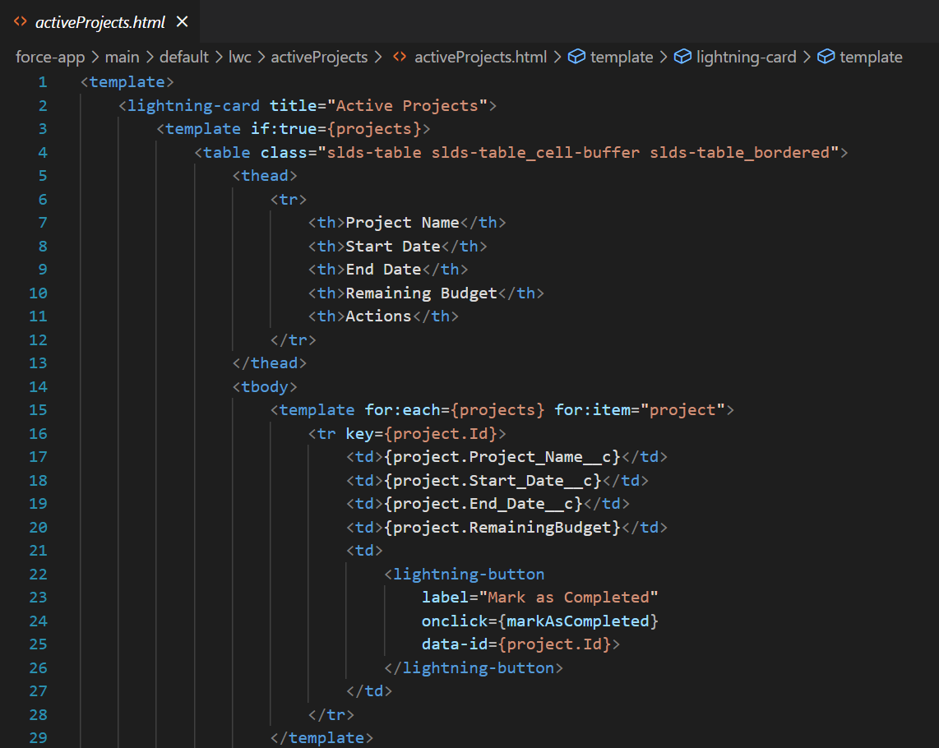
HTML code

Slide 14
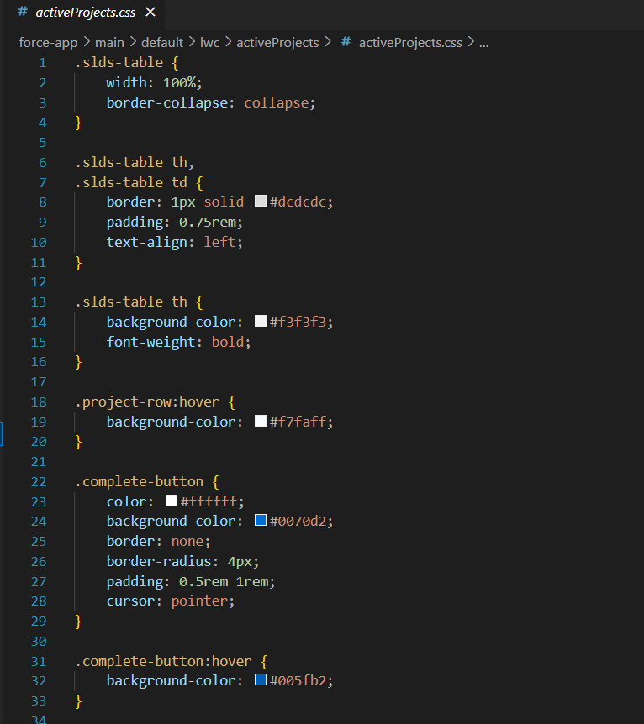
Css Code

Slide 15
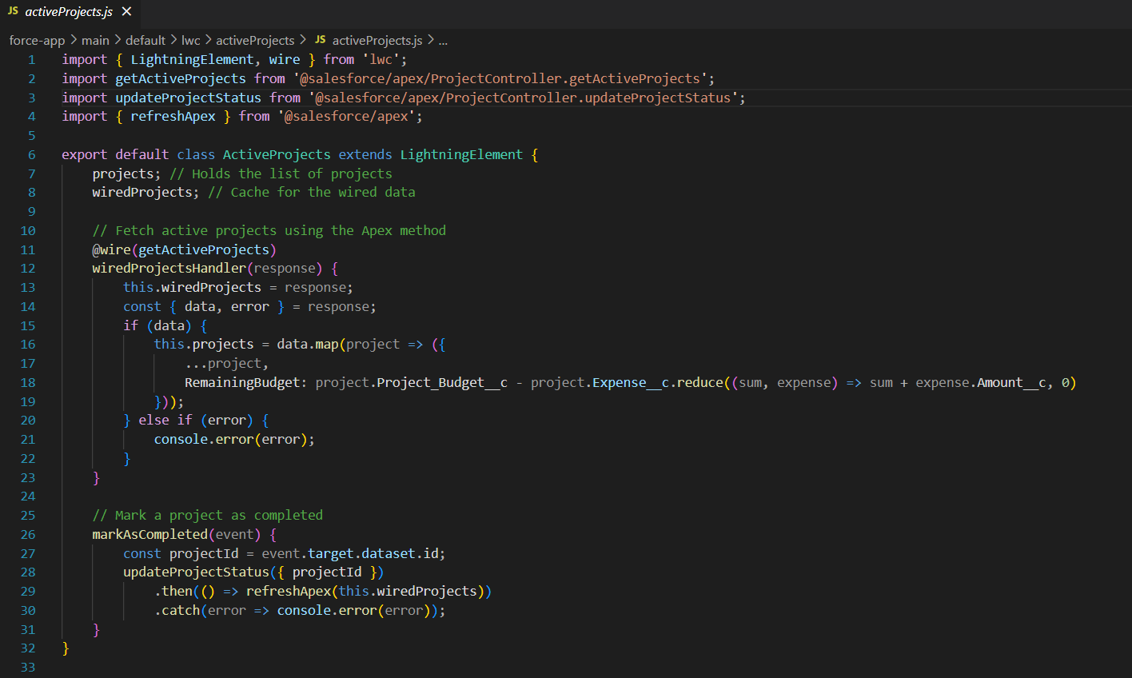
Javascript code

Slide 16
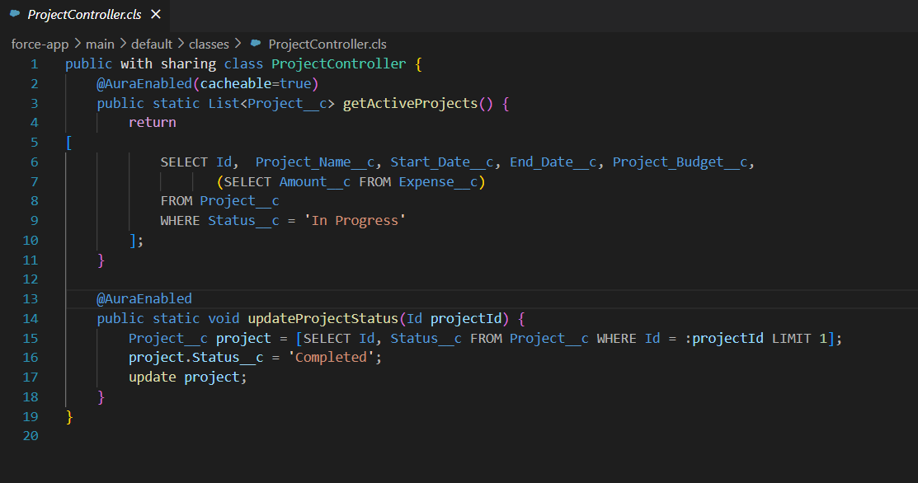
Apex Controller code

Slide 17
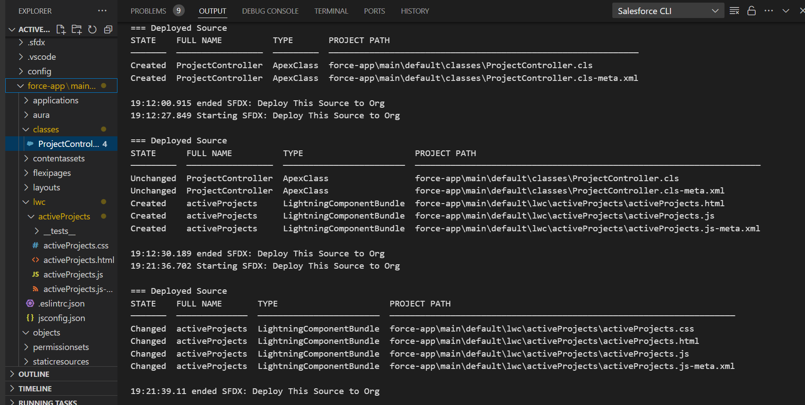
Deployment

Slide 18
Thank You

